Slide 1
Acme Sprocket Company
Back-End Lesson #3-
Data Access Layer,
H2,
Exception Handling,
Mocking
Notes:
Talk about:
The plan to move to a multi-module project
Parent pom –> SLN file (solution file)
Reiterate – Java annotations are a big part of Spring
Seems more annotation-heavy than C#
Go through files and compare
Response Entity -> IActionResult
Routing = the same
Validation -> attribute
Request variable, path variables seem similar
Naming convention of the Interface/ServiceImpl
Mocking – when we add the persistence layer
Lesson 2
Overview: Services & DI
Library: (Mockito, Moq)
Code: (What to Register as What, (Singleton, Transient, Scoped))
Testing: Introduce Mocking
Pattern: Proxy
Config: TBD
CI/CD: restore/build/run tests

Slide 2
Back-End Lesson 3 Plan Code Demo Questions For Further Reading Next Session
Agenda
Notes:
TODO:
Complete unit tests
Mock persistence layer in testing
Project structure: parent project with sub-projects (or modules)

Slide 3
Data Access Layer H2 database Exception Handling Mocking in Unit Tests
Back-End Lesson 3 Plan

Slide 4

Code Demo
Notes:
https://twitter.com/unclebobmartin/status/1517554583089958914

Slide 5
Questions?

Slide 6
Links to articles here
For Further Reading…

Slide 7
Front-End Lesson 3: Back-End Lesson 4:
Next Sessions

Slide 8
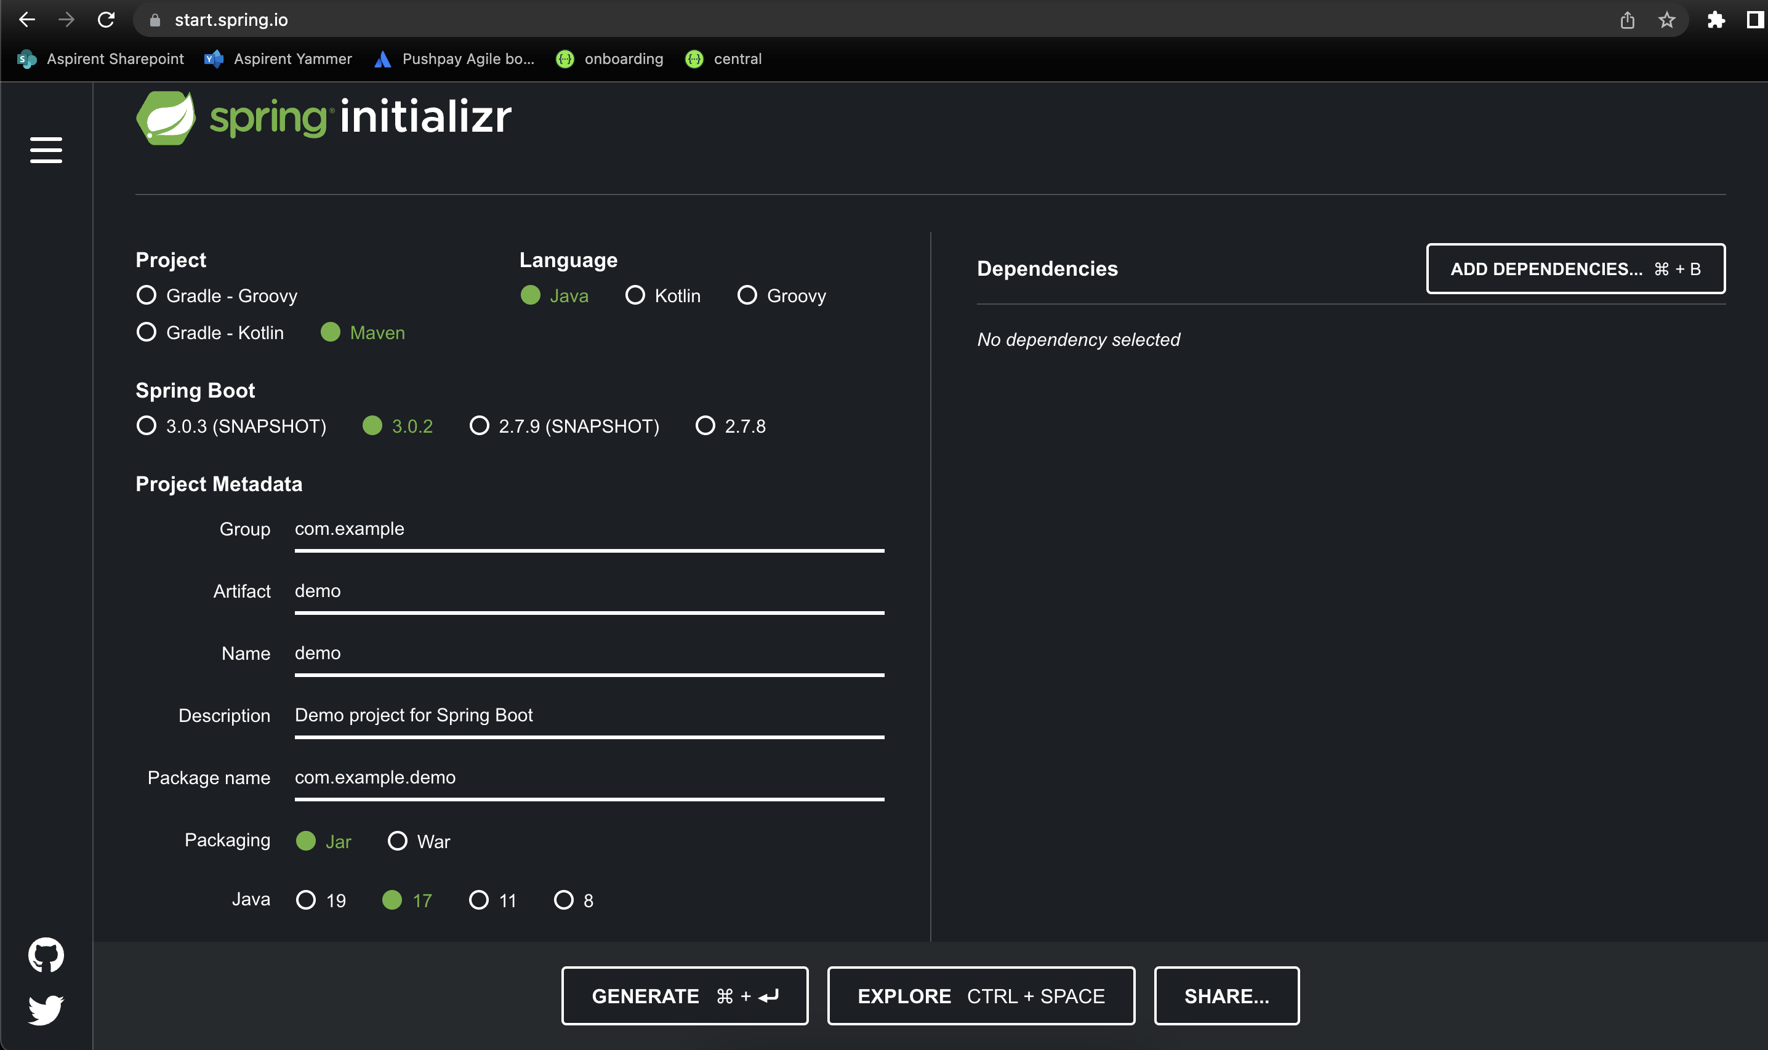
How Do I get started with Spring Boot?
Spring provides a website to create and download preconfigured and working empty projects to get you started quickly!
https://start.spring.io/

Slide 9
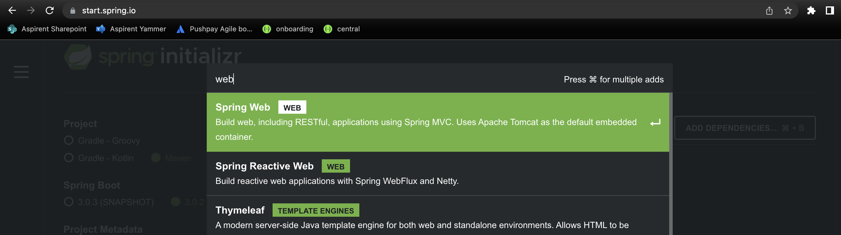
Creating an empty REST controller project
As simple as going to start.spring.io and searching for the “web” dependency!

Slide 10
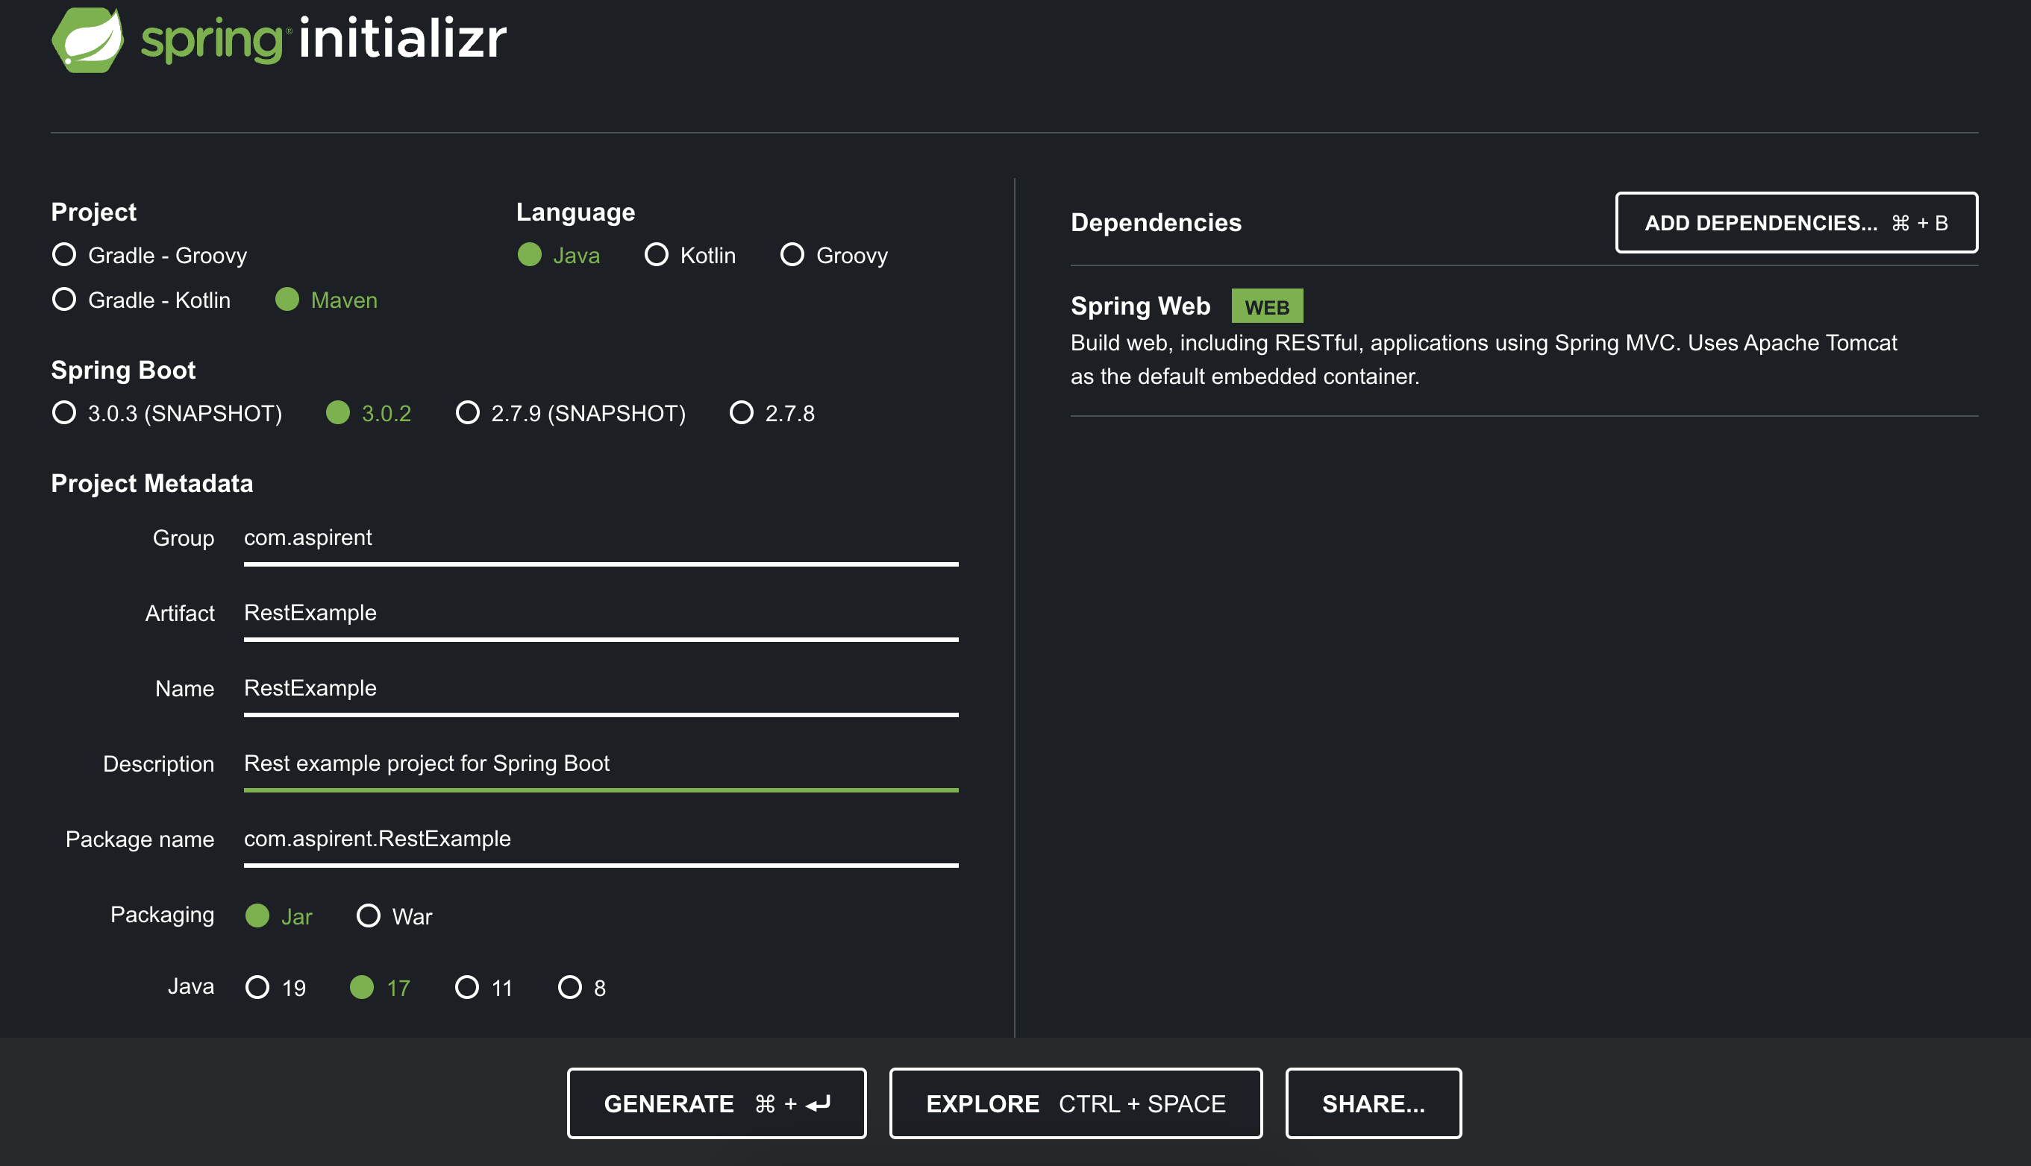
Generating an empty REST controller project

Slide 11
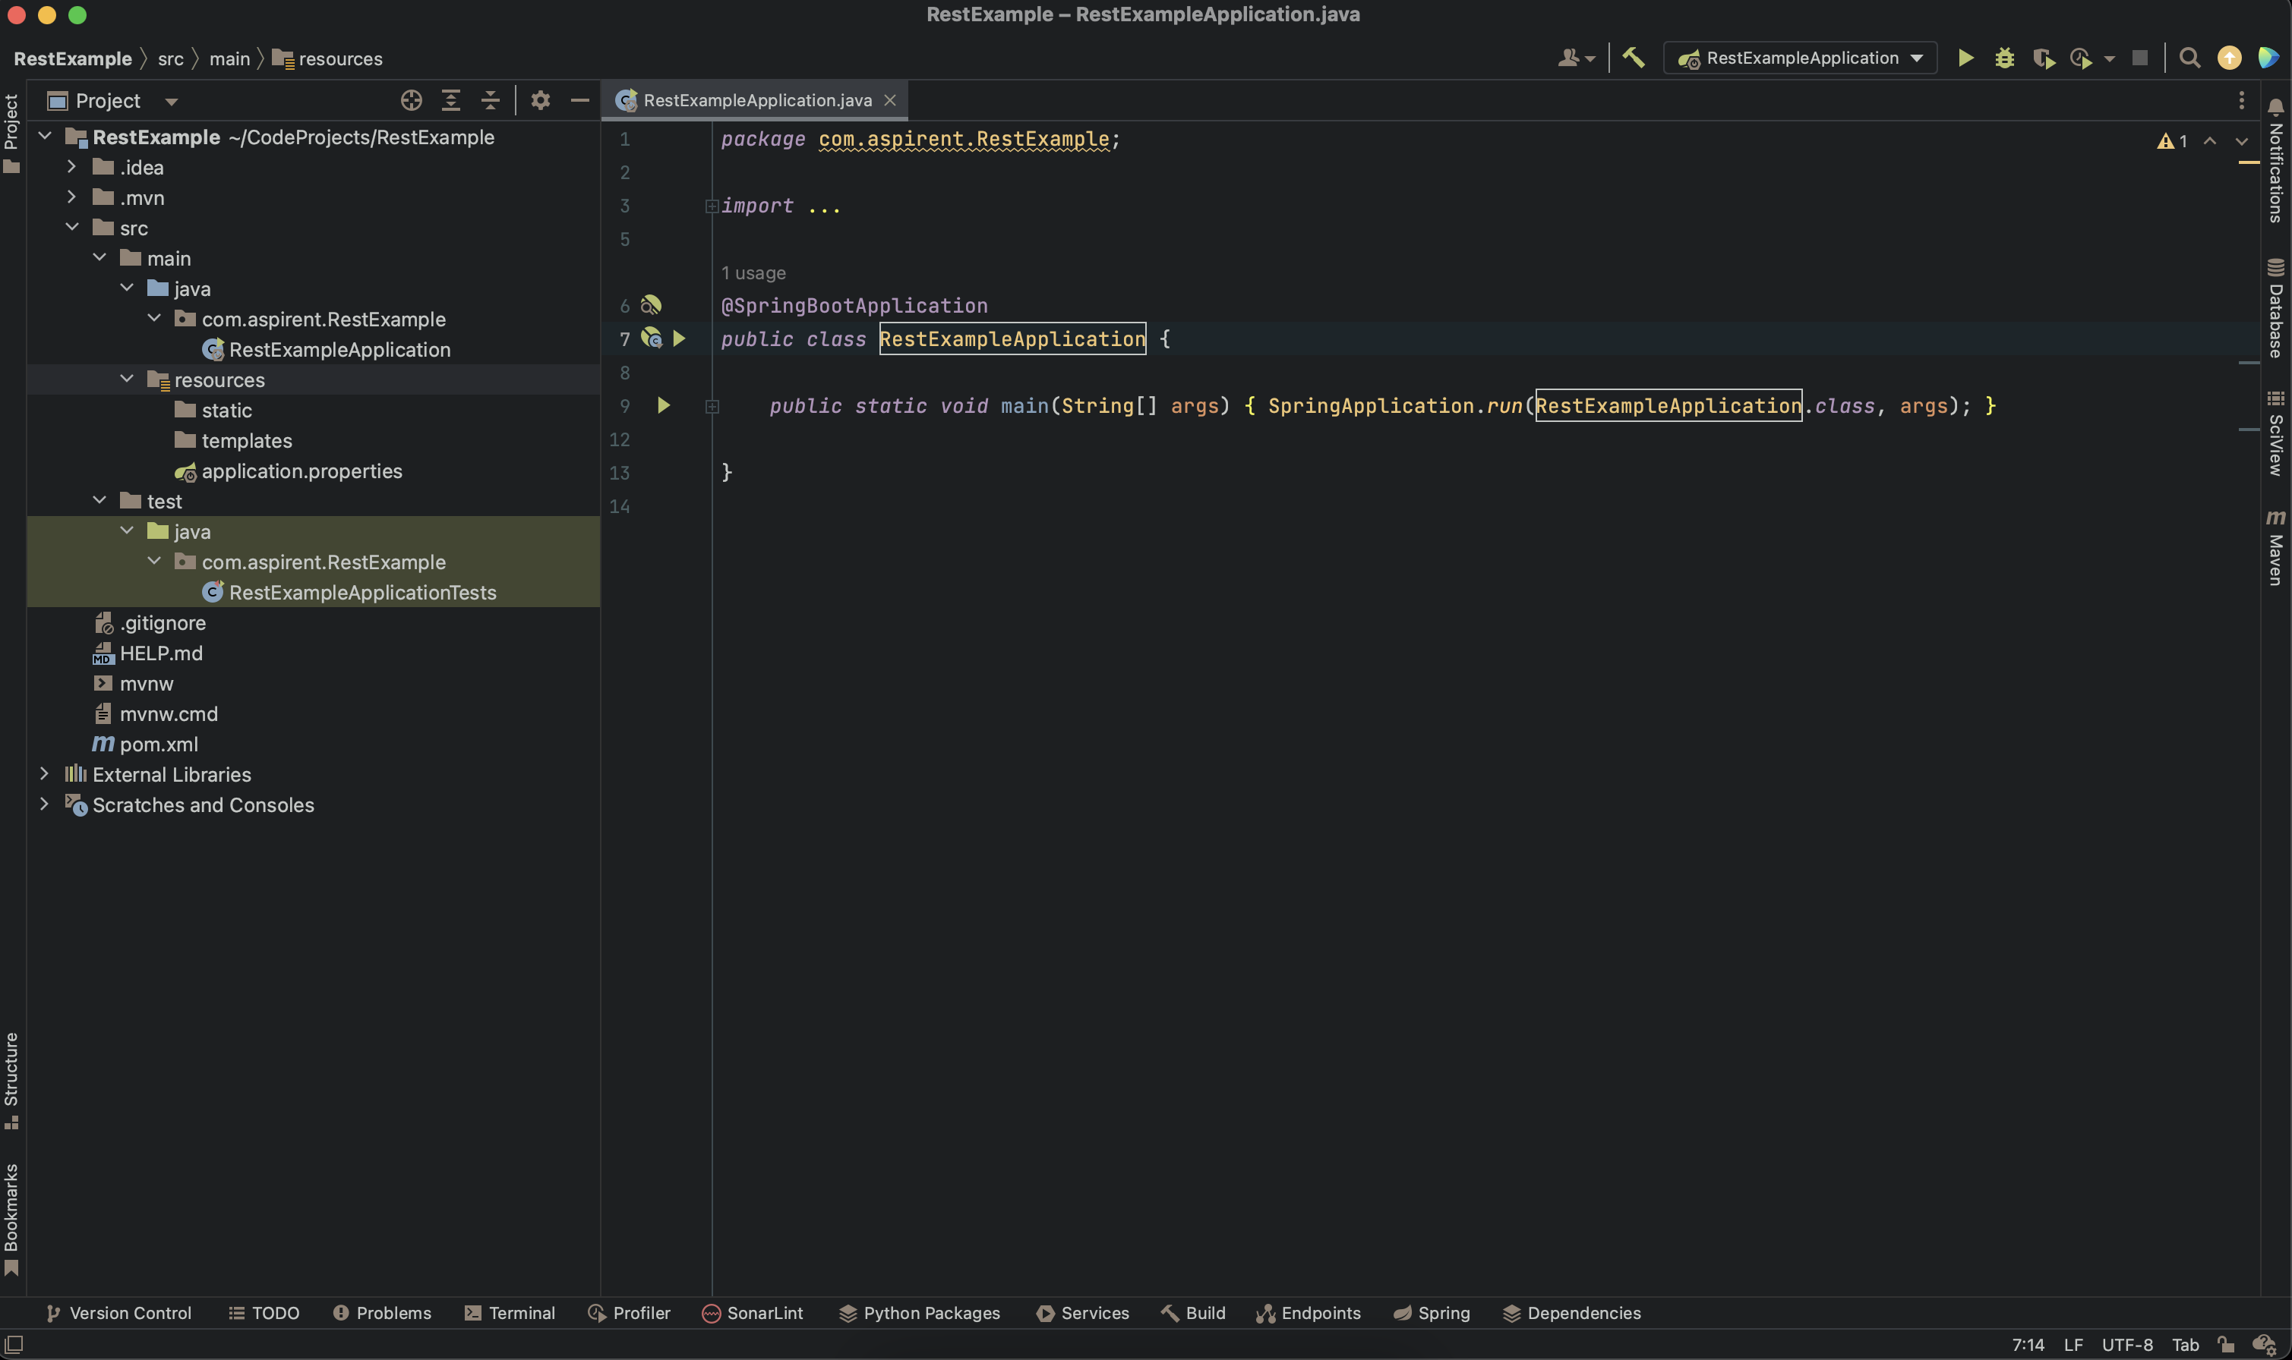
What does the newly downloaded zip file include?

Slide 12
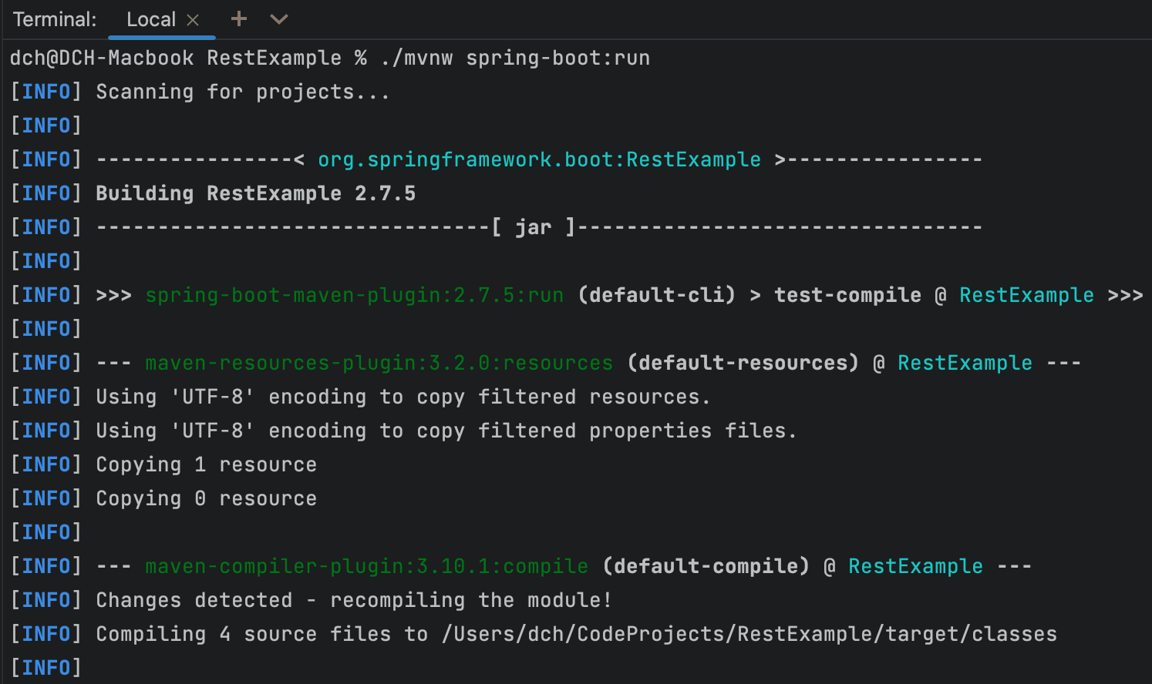
Since we’re using Maven we’ll run the app through the the maven wrapper:
How to run the newly generated project:
./mvnw spring-boot:run

Slide 13
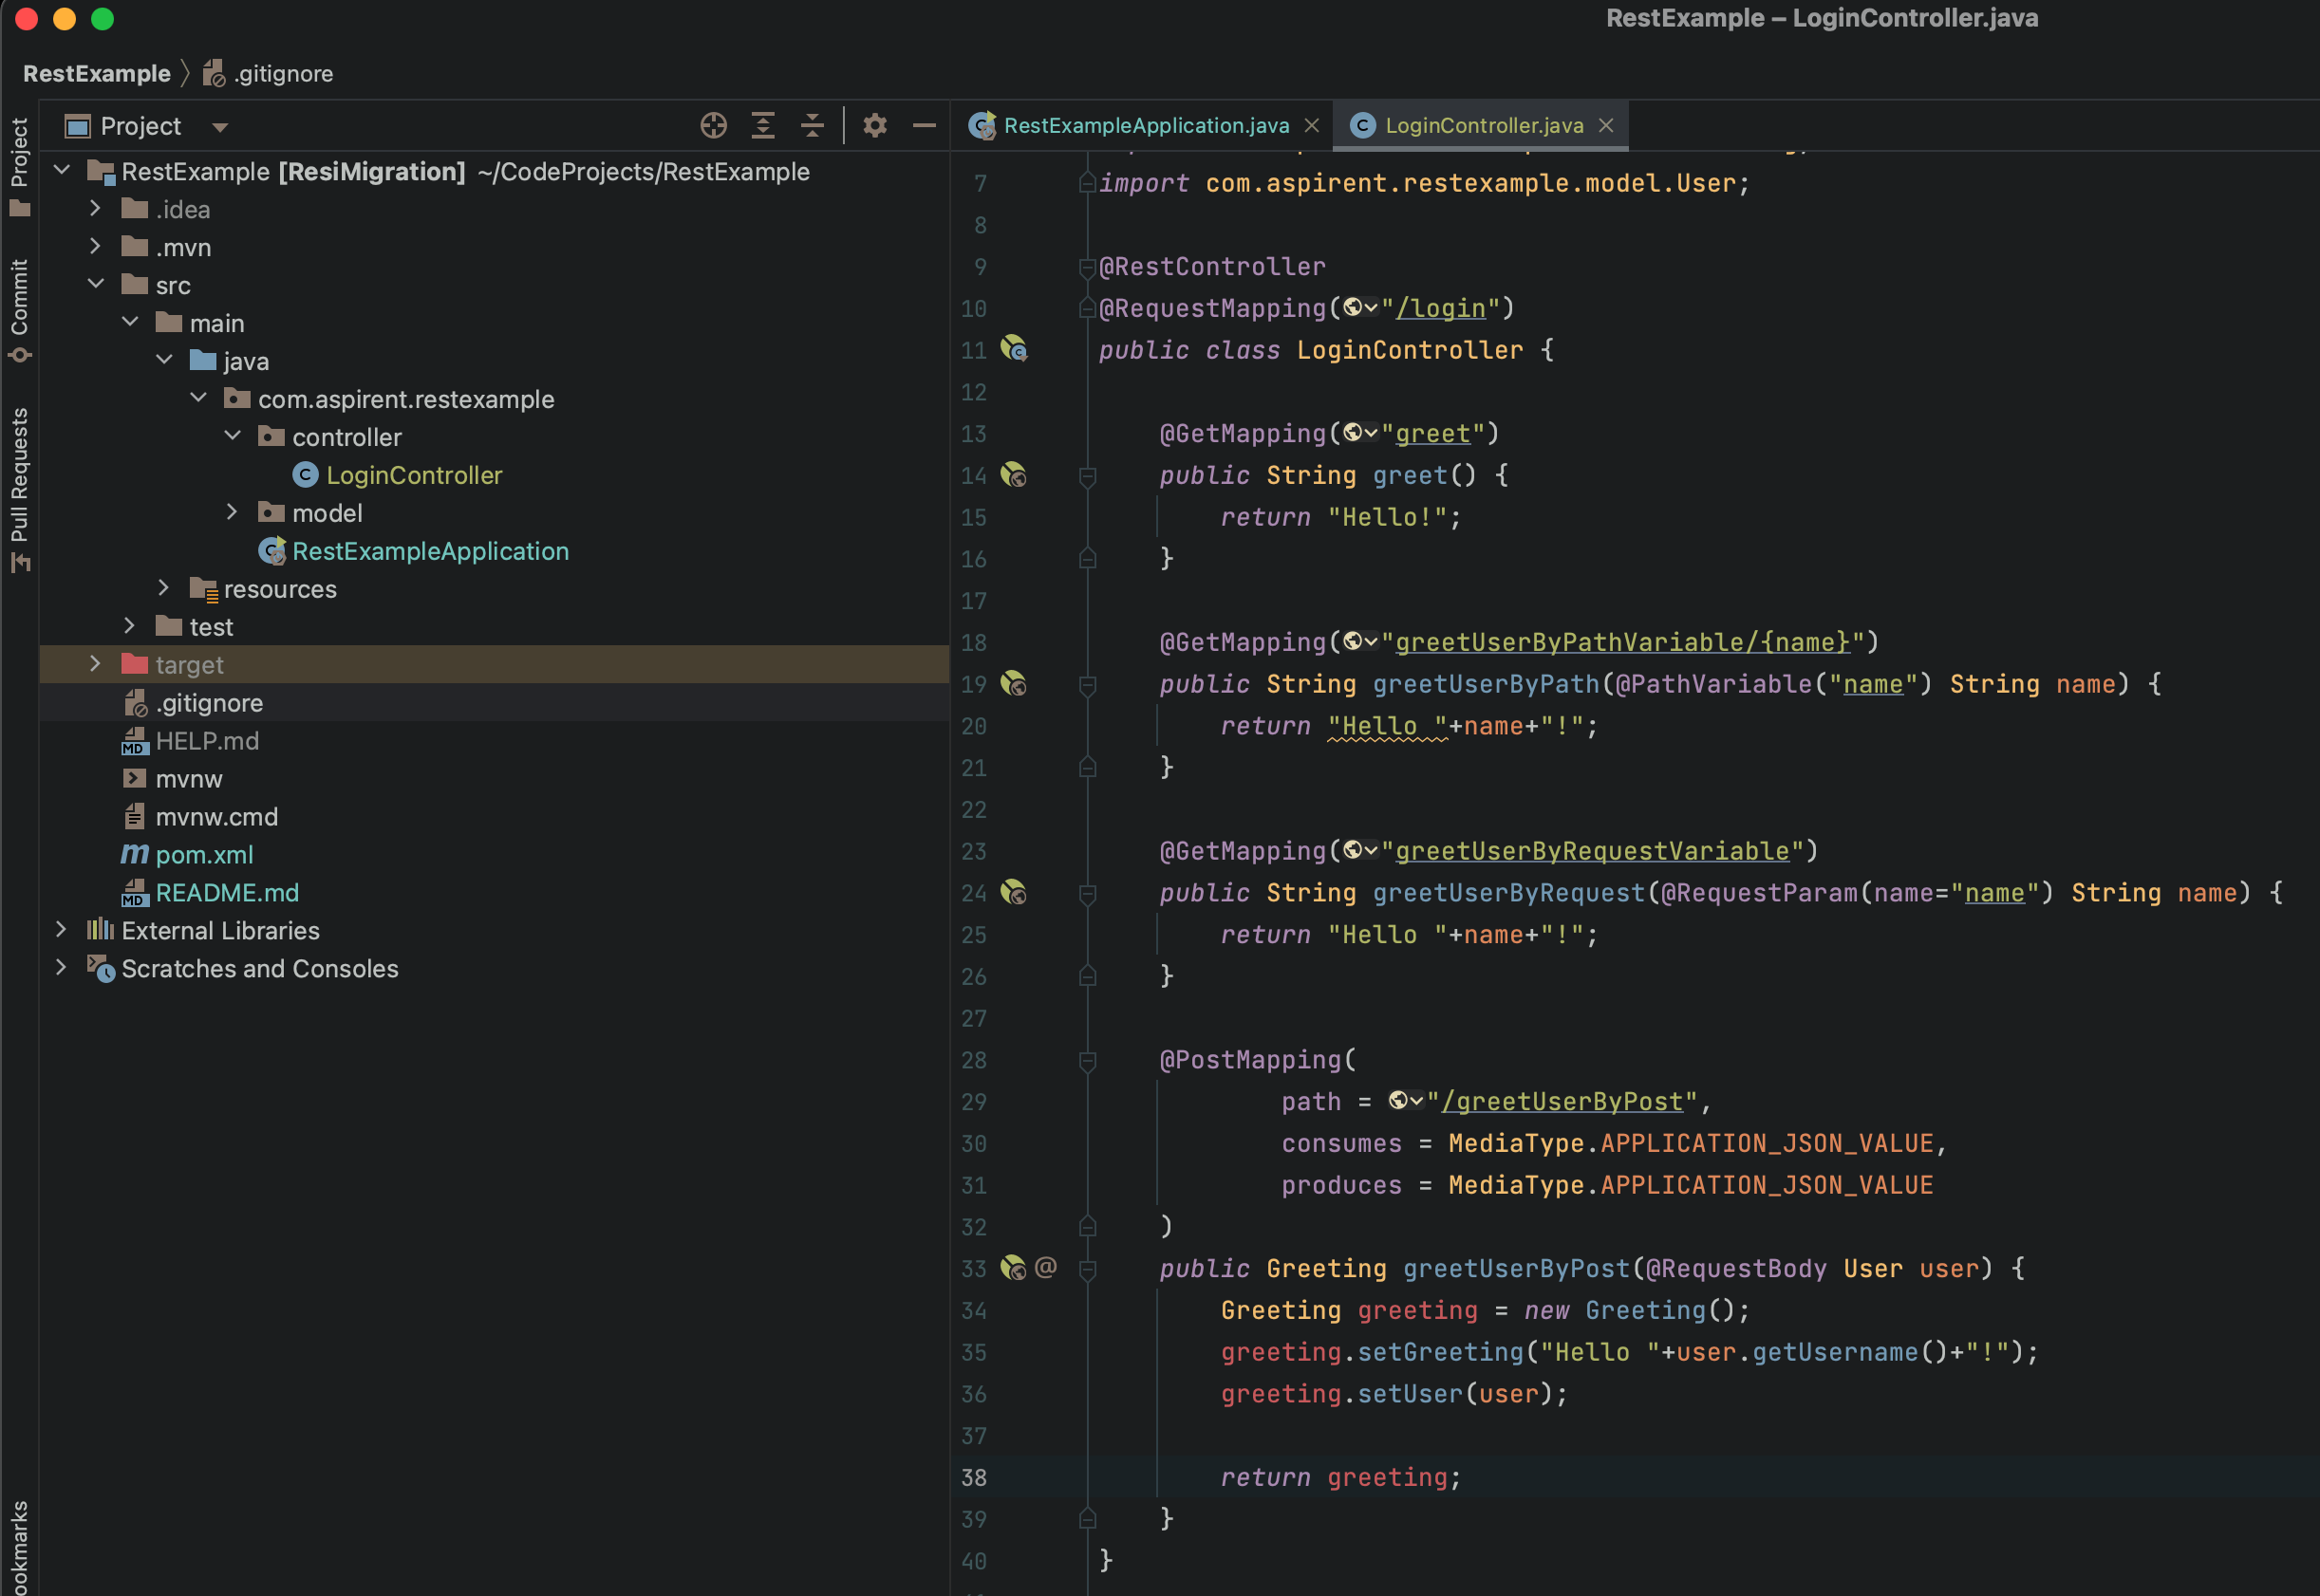
Create a basic Controller class:

Slide 14
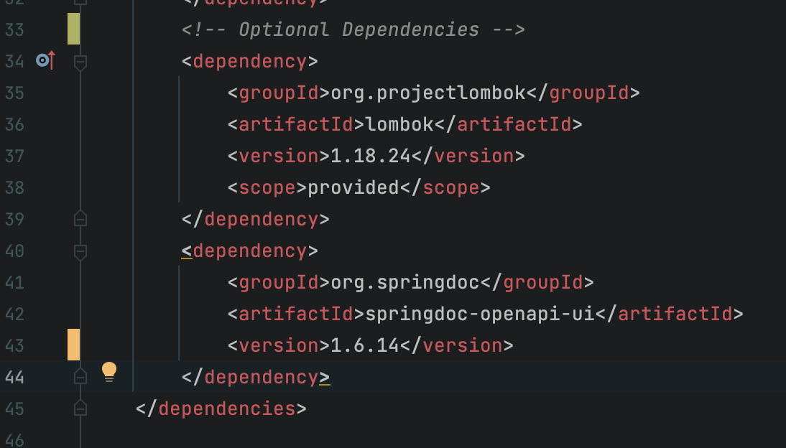
Since we’re using Maven we add the two libraries to our pom.xml
Let’s add Swagger and Lombak:

Slide 15
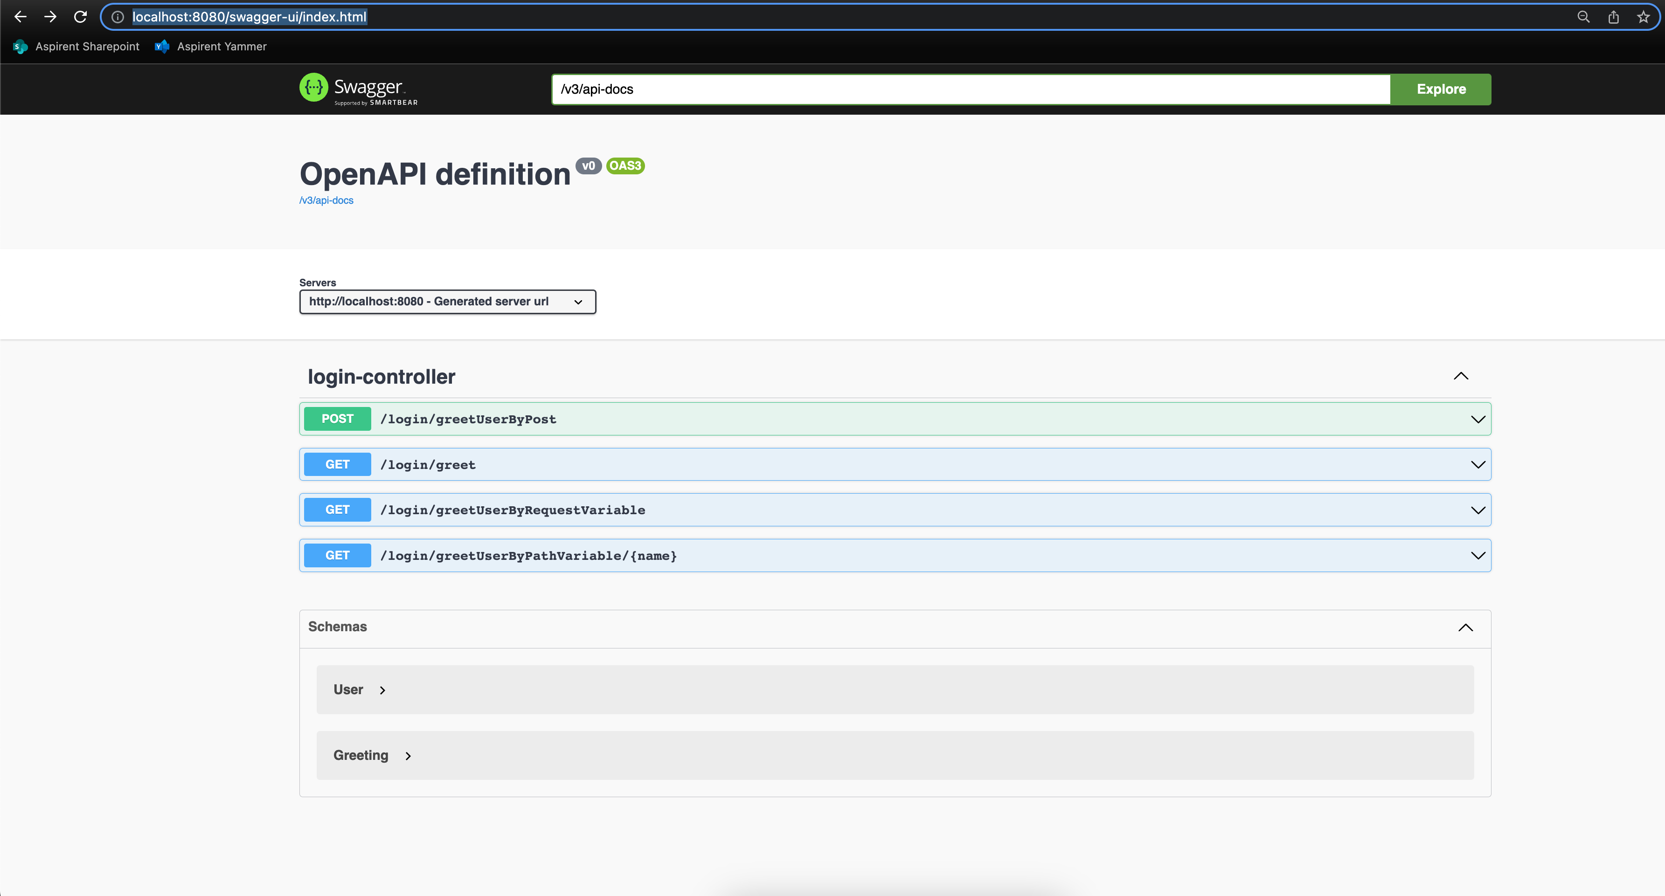
Navigate to: http://localhost:8080/swagger-ui/index.html
What does Swagger give us:

Slide 16
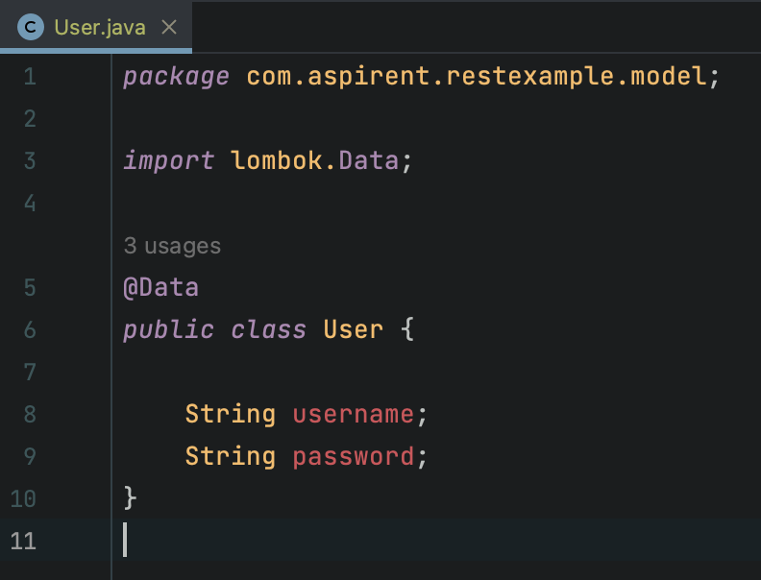
Automatic getter and setter creation:
What does Lombak give us:

Slide 17
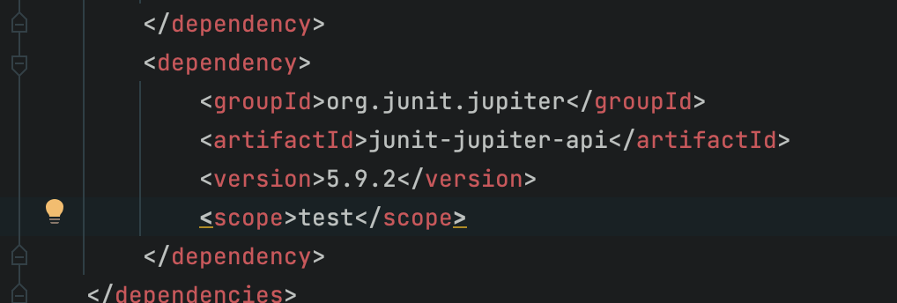
Add the Junit Dependency :
Adding Unit Testing

Slide 18
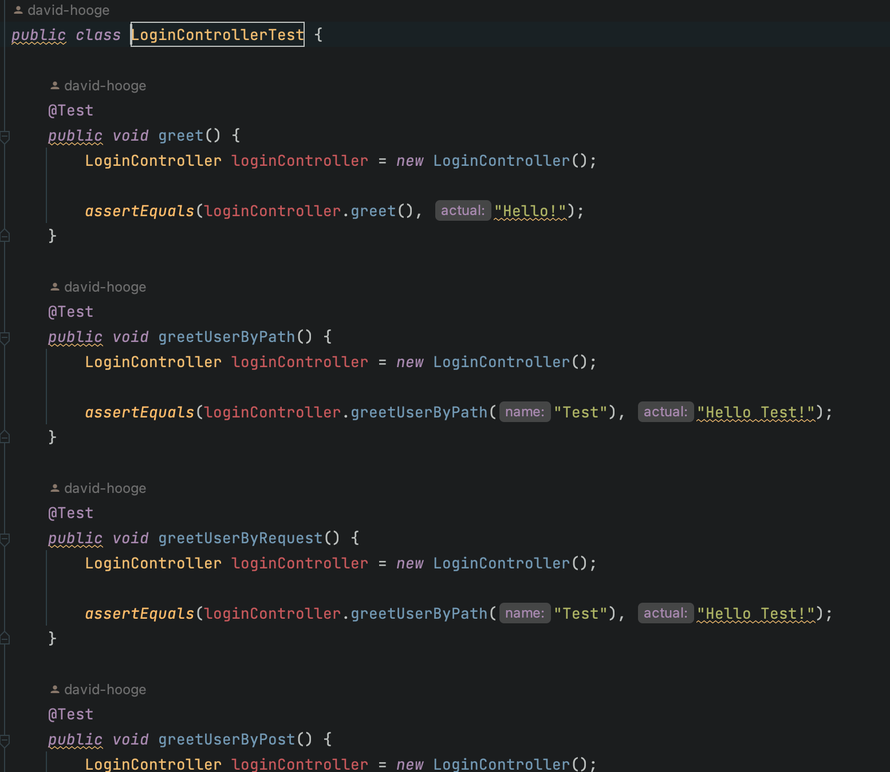
Add testing code:
Adding Unit Testing

Slide 19
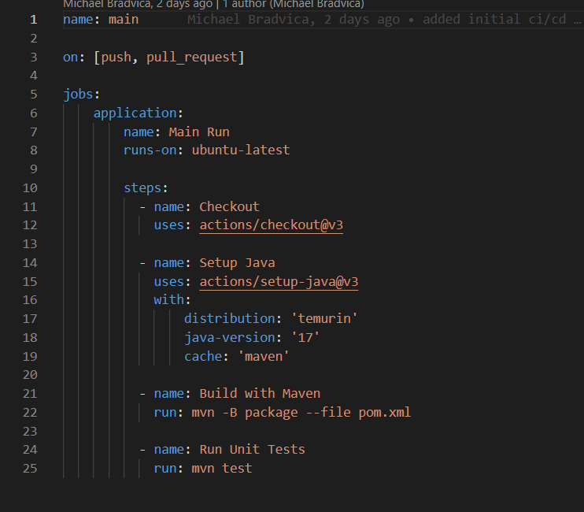
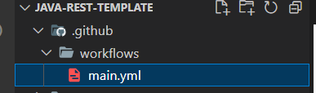
CI/CD for Java
CI/CD for Java follows the same fundamentals as our front-end config
The biggest differences are the commands needed-but the structure is the same

